Slide 1

California Wildfire in years from 2005-2015
Group Name: Breaking Bad
Presentation speaker: Jade
Other Group members: Jiaqi, Renqi, Tianliang

Slide 2
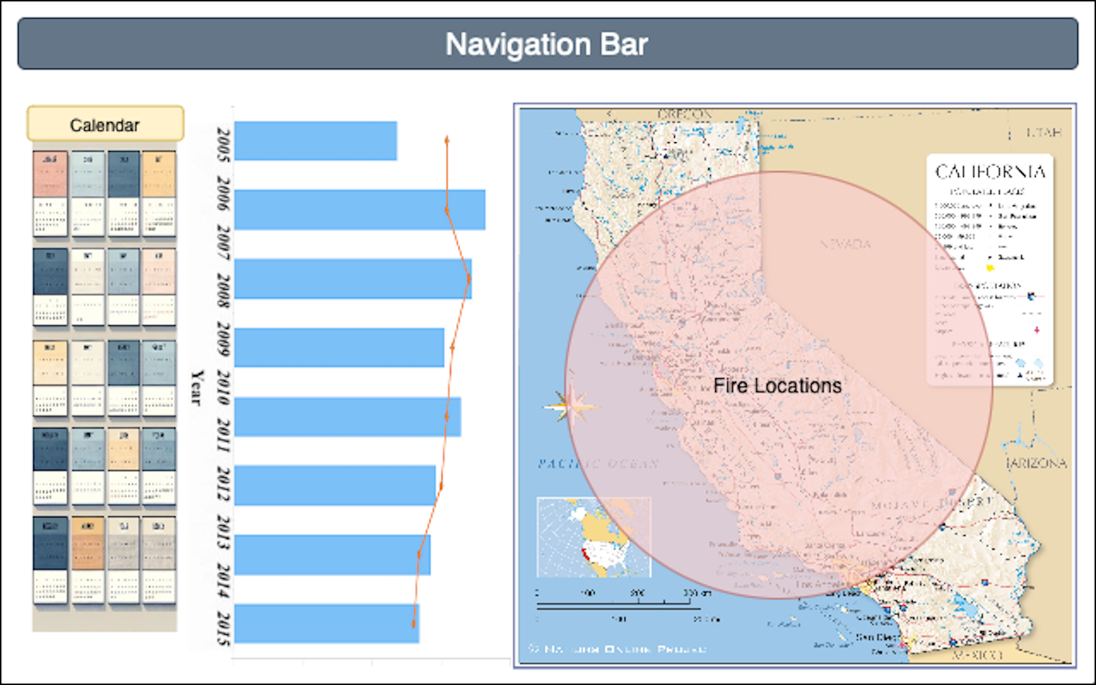
Design Phase: Home Page Layout Design

Slide 3
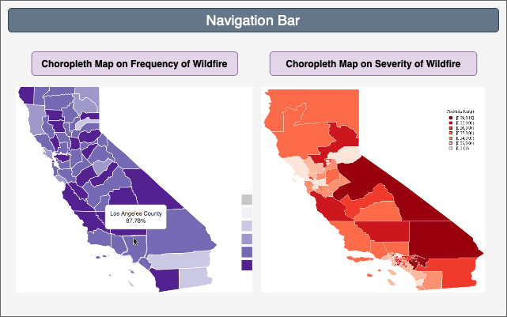
Design Phase: Choropleth Page Layout Design

Slide 4
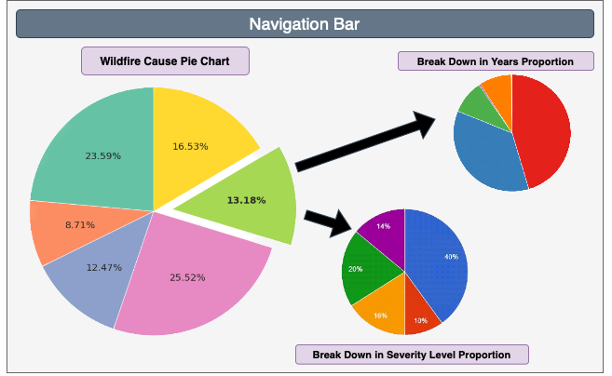
Design Phase: Pie Chart Page Layout Design

Slide 5
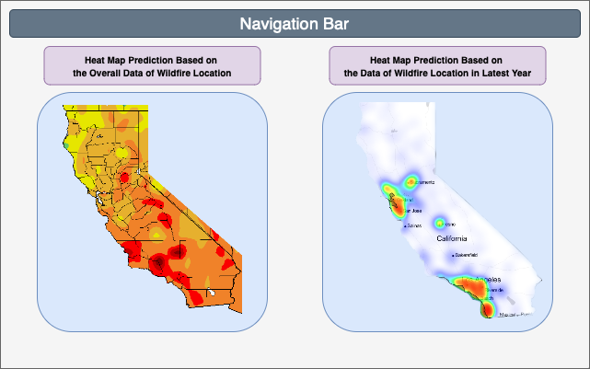
Design Phase: Pie Chart Page Layout Design

